Slide 1
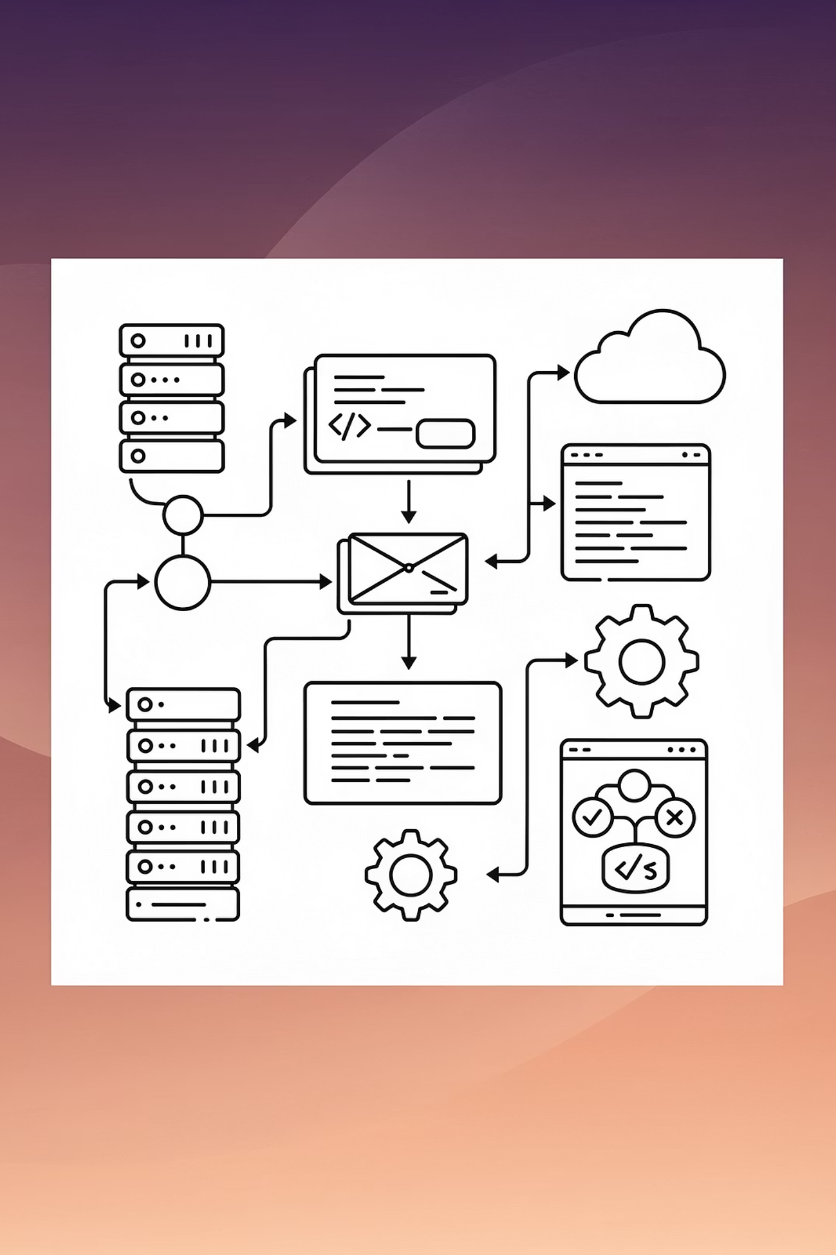
Boosting Developer Productivity via Atlassian APIs
Streamlining the software development lifecycle through intelligent API integration and AI-assisted coding

Slide 2
Overview
From Documentation to implementation
Modern software development demands efficiency at every stage. This presentation explores a powerful workflow that bridges documentation, specification, and implementation through intelligent automation.
By the end of this session, you'll understand how to:
Extract and process Confluence documentation automatically
Leverage Jira as your single source of truth for specifications
Accelerate development with AI-assisted coding
We'll examine how Atlassian APIs enable seamless data extraction from Confluence and Jira, whilst GitHub Copilot transforms specifications into production-ready code.

Slide 3




The Foundation: Understanding Atlassian APIs
Confluence API
Jira API
Authentication
RESTful interface for accessing pages, spaces, and content. Supports rich querying, content manipulation, and metadata extraction.
Comprehensive access to issues, projects, workflows, and custom fields. Enables automation of ticket management and reporting.
Token-based authentication ensuring secure, programmatic access to your Atlassian resources without compromising credentials.
Both APIs provide robust, well-documented endpoints that form the backbone of our development workflow.

Slide 4
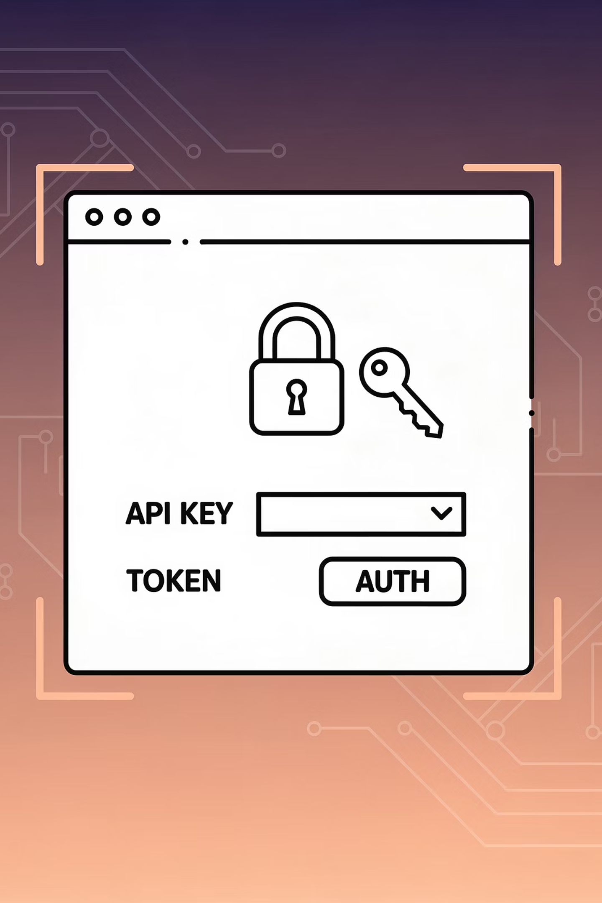
Setting Up API Access: Your First Steps
01
Request Access
Add yourself to ACG-All-Atlassian-Macquarie-API-Users via SailPoint
02
Generate Token
Visit id.atlassian.com/manage-profile/security/api-tokens to create your personal API token
03
API Token Storage
Store tokens securely using environment variables
04
Test Connection
Validate your setup with a simple API call to confirm authentication works correctly

Slide 5
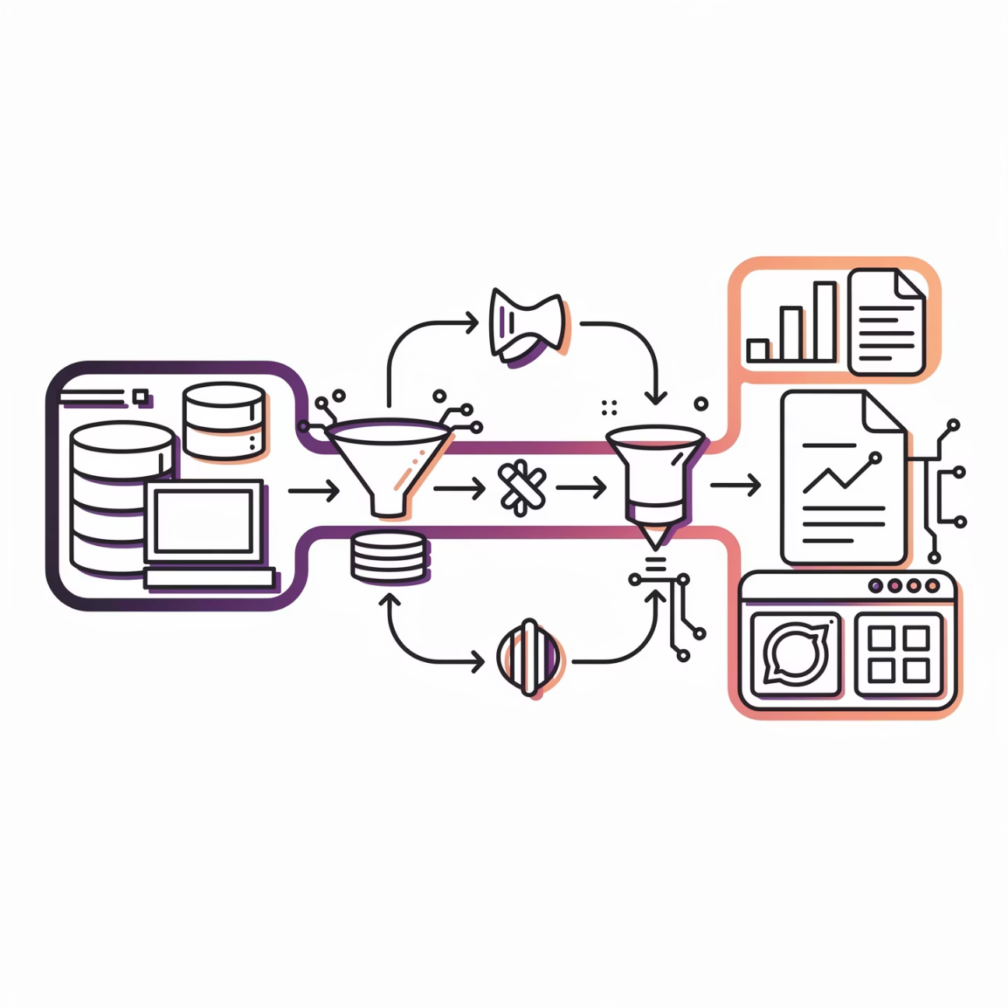
Extracting Confluence Content
Building Your Extraction Tool
The Confluence API provides powerful endpoints for content retrieval. Our extraction tool leverages these to programmatically access documentation, technical specifications, and knowledge base articles.
Key capabilities include:
Batch retrieval of pages from specific spaces
Content filtering by labels, authors, or modification dates
Extraction of rich text, attachments, and inline comments
Version history tracking for audit trails
The tool handles pagination automatically, ensuring complete data retrieval regardless of content volume.

Slide 6
Calling the Confluence Extraction Script
This section outlines how to use the Confluence API extraction script with various command-line options for efficient content retrieval. The script is designed for flexible operation, allowing for full re-fetches, test runs, and resumable extractions.
Usage Pattern
Usage: python fetch_confluence_pages.py [OPTIONS]
Available Options
--force, -f: Re-fetch all pages, even if they already exist in the database, overwriting previous data.
--test, -t [N]: Activate test mode. The script will stop after fetching a specified number of pages (N). If N is not provided, it defaults to 10 pages.
--help, -h: Display the help message, detailing all available options and their descriptions.

Slide 7
Confluence Script Examples
Practical Examples
python fetch_confluence_pages.py # Performs a normal, resumable fetch, skipping existing pages.
python fetch_confluence_pages.py --test # Runs in test mode, fetching the default of 10 pages.
python fetch_confluence_pages.py --test 25 # Runs in test mode, fetching a specific count of 25 pages.
python fetch_confluence_pages.py --force # Forces the script to re-fetch and overwrite all pages.
python fetch_confluence_pages.py --force --test 5 # Forces a re-fetch of all pages, but stops after 5 pages in test mode.

Slide 8
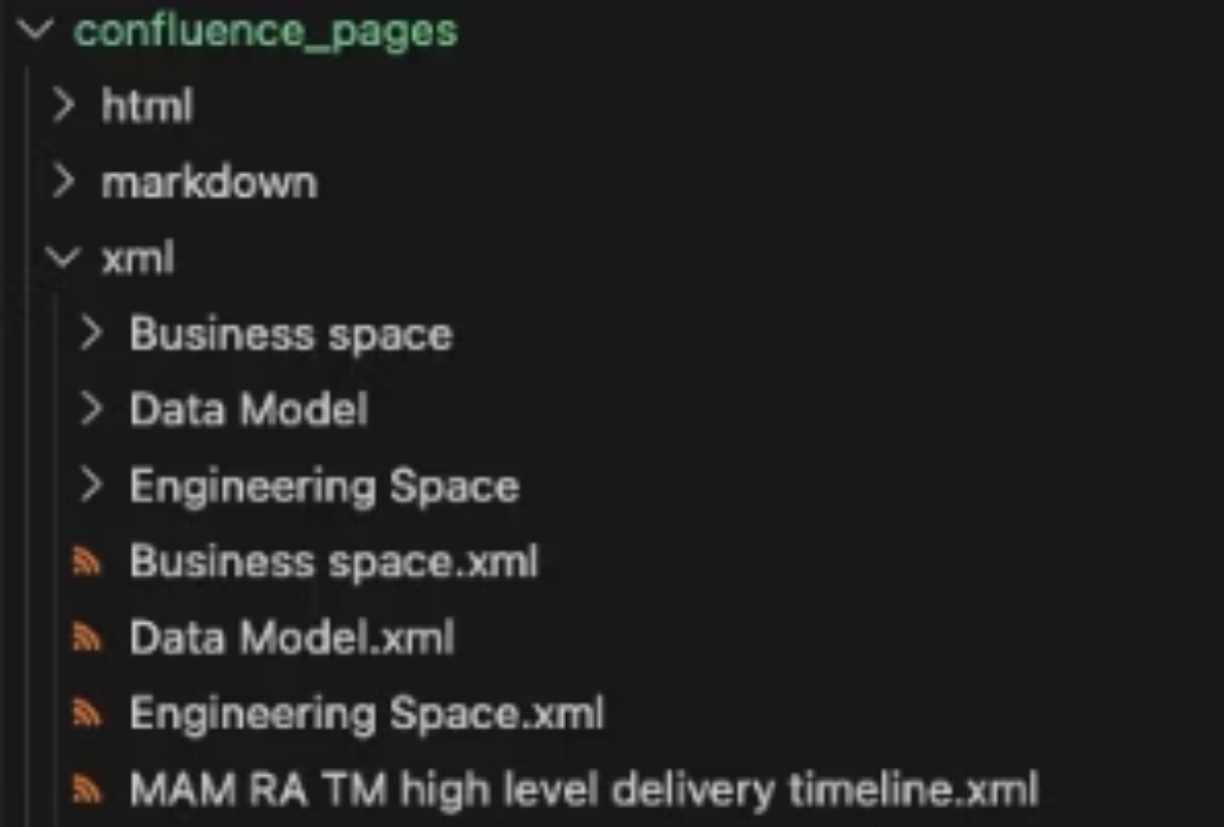
Output Structure: Pages to Files
After successful extraction, Confluence content is systematically organised into a clean, intuitive folder and file structure on your local system or designated storage.
Each Confluence space becomes a distinct folder, containing all its associated pages and attachments, making content easily navigable and accessible outside the Confluence environment.
Structured Folders
XML Export
Each Confluence space is mapped to a dedicated folder, ensuring a logical grouping of content for efficient retrieval and management.
Pages are exported as XML files, preserving their rich structure, metadata, and versioning details crucial for programmatic processing and analysis.

Slide 9
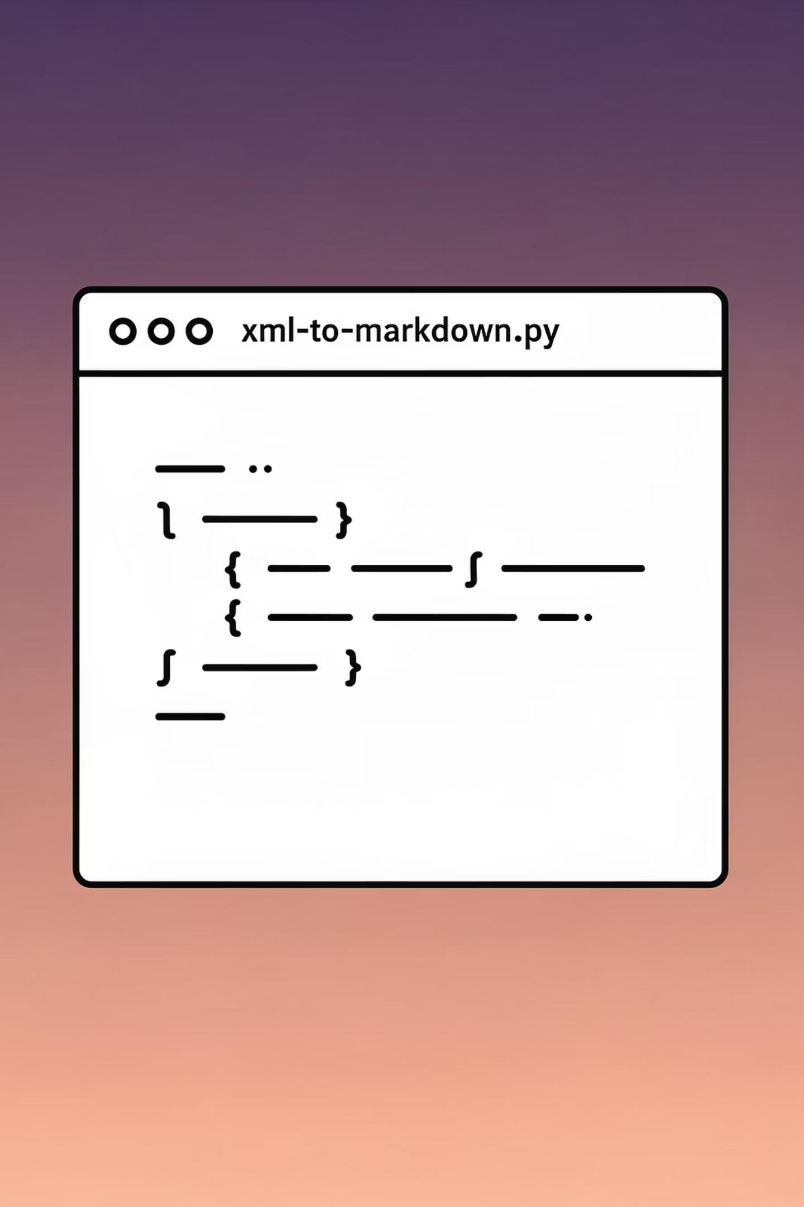
Optional Step: Converting to Markdown Format
This optional step uses the xml_to_markdown.py script to convert extracted Confluence XML files into a clean Markdown format.
The conversion enhances readability and compatibility with various documentation platforms. A valid OpenAI API access key is required for this functionality, but its provision and management are outside the scope of this presentation.
python xml_to_markdown.py

Slide 10

Using Copilot to Summarise Confluence Content
Once we've extracted Confluence documentation, GitHub Copilot becomes an invaluable tool for generating concise summaries and extracting key requirements.
The process involves:
Feeding extracted content into your development environment
Using Copilot Chat to analyse and summarise lengthy documentation
Extracting actionable requirements and technical specifications
Generating structured outputs suitable for Jira ticket creation
Copilot's understanding of technical context ensures summaries capture nuances that simple text processing might miss.

Slide 11



Leveraging Jira as Your Specification Source
Requirements
Implementation
Delivery
Jira tickets contain detailed acceptance criteria, technical constraints, and user stories
Extract specs via API and feed them to Copilot as context for code generation
Automatically update ticket status and link commits back to issues
This creates a closed loop where specifications drive development, and progress updates flow back automatically, maintaining traceability throughout the software lifecycle.

Slide 12
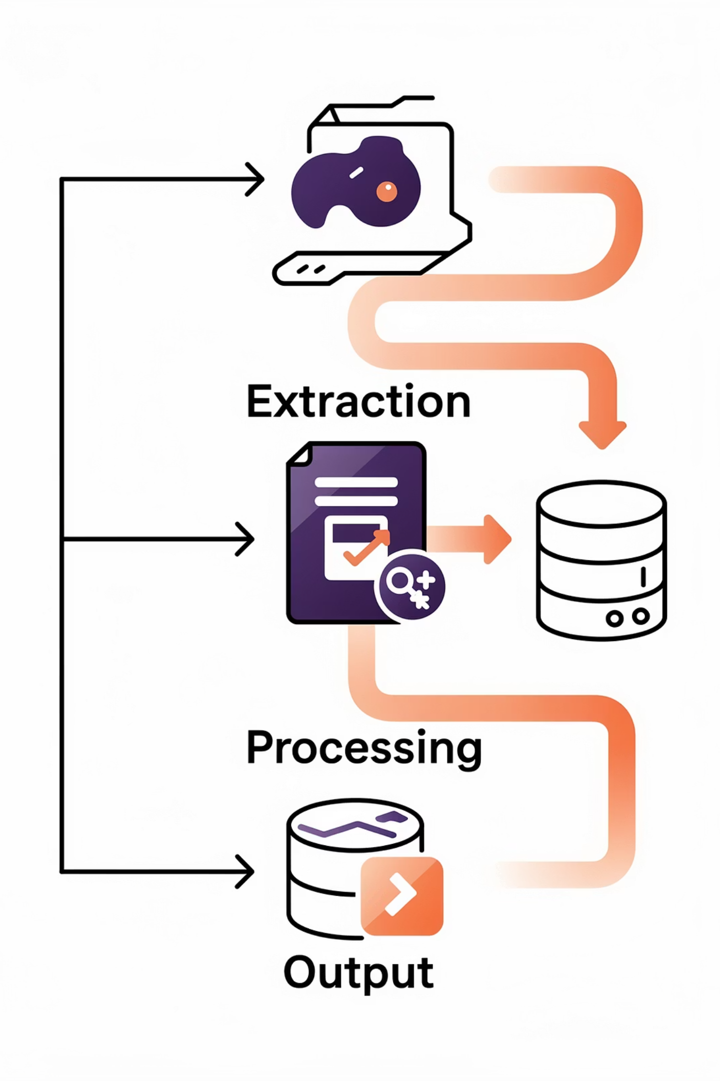
Extracting Jira Specifications
The Jira API provides comprehensive access to issue data, enabling automated extraction of specifications that serve as the foundation for development work.
Query Construction
Relationship Tracking
Use JQL (Jira Query Language) to precisely target relevant issues. Filter by project, sprint, assignee, or custom fields to retrieve exactly what you need.
Preserve links between issues, subtasks, and dependencies. This context helps Copilot understand the broader scope of your implementation.

Slide 13
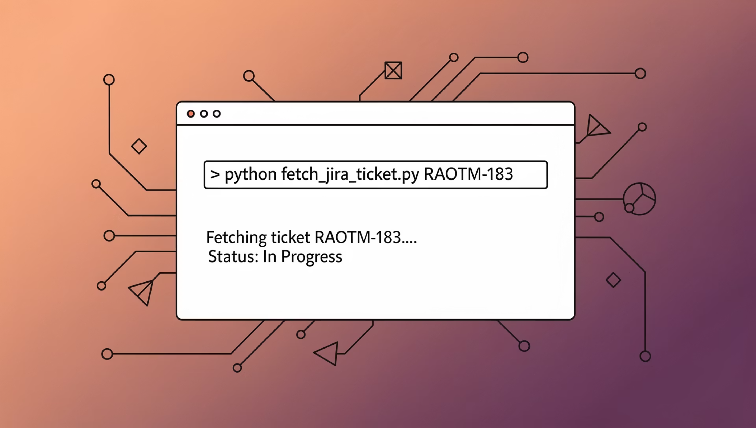
Running the Jira Extraction Script
To extract information from Jira tickets using the script, execute the following command in your terminal:
python fetch_jira_ticket.py RAOTM-183

Slide 14
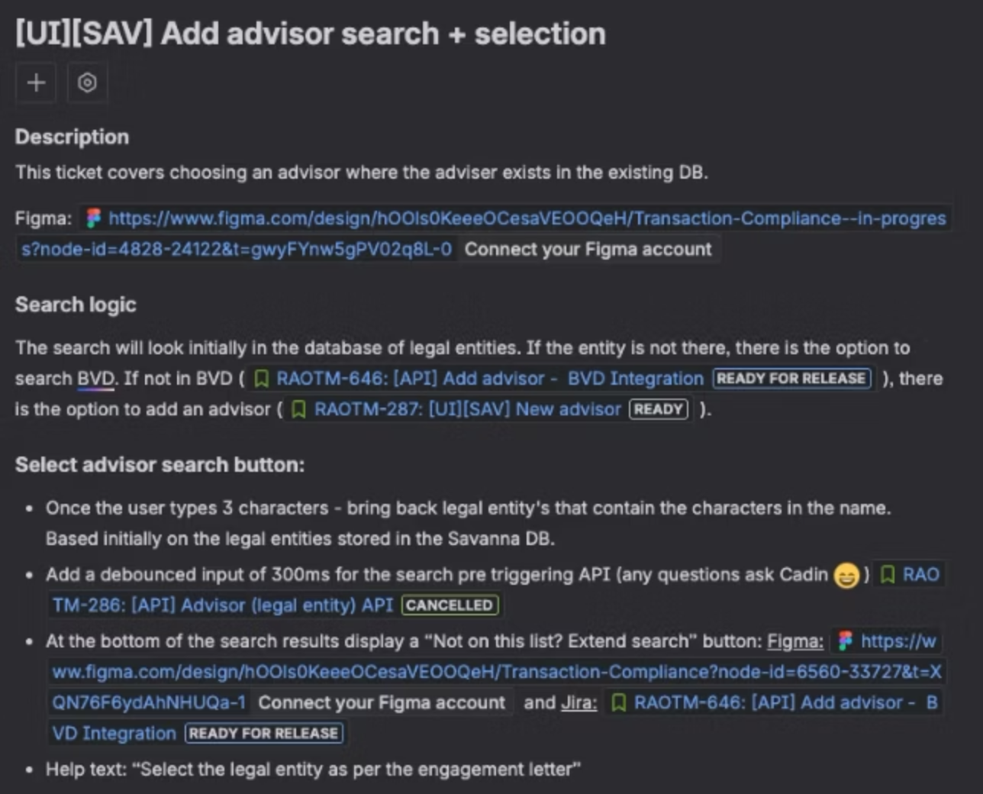
Original Format in Jira Web

Slide 15
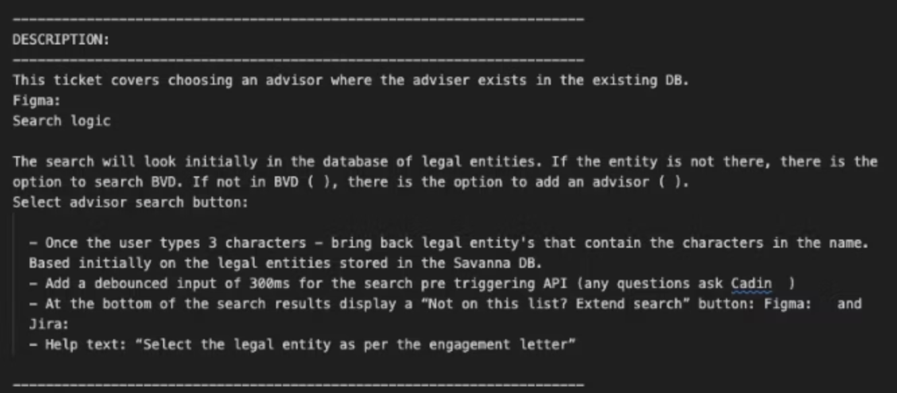
Extracted Content in Markdown

Slide 16
The Integration Workflow
Extract Confluence Docs
1
Retrieve relevant documentation and technical specifications using the Confluence API
2
Summarise with Github Copilot
Use GitHub Copilot to analyse content, generate summaries, and identify key requirements
Fetch Jira Specs
3
Pull detailed issue specifications that define implementation requirements
4
Context-Aware Coding
Feed specifications to Copilot as context for generating implementation code
Update & Link (coming soon)
5
Automatically update Jira with progress and link commits back to issues

Slide 17


Common Challenges and Solutions
API Rate Limiting
Copilot Context Limitations
Challenge: Hitting rate limits during bulk operations
Challenge: Limited context window for large specifications
Solution: Implement exponential backoff, batch requests efficiently, and cache responses where appropriate
Solution: Break specs into logical chunks and provide targeted context for each coding session

Slide 18
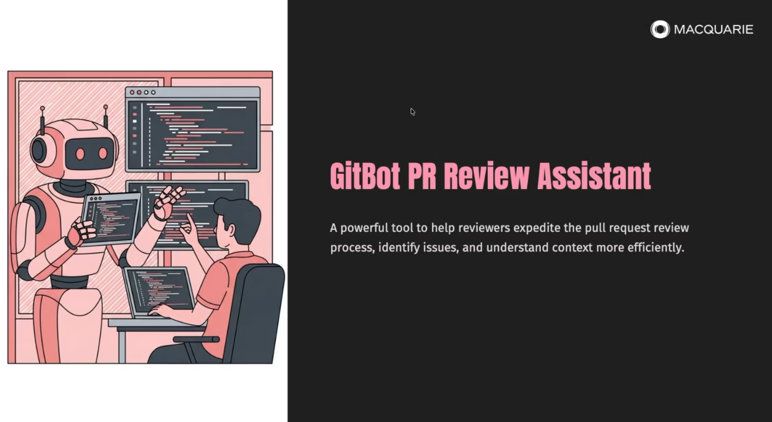
Previous Sharing on CI Pipeline

Slide 19

Future Enhancements
What's Next?
The intersection of API automation and AI-assisted development continues to evolve rapidly. Future enhancements might include:
Exploring the Claude Code and Jira MCP
Smart Requirement Analysis: AI tools that spot unclear requirements and recommend improvements
Automated Test Generation: Copilot creating comprehensive test suites directly from Jira acceptance criteria

Slide 20



Start Building Your Automation
Get Started Today
Join the Community
Request API access via SailPoint
Connect with other developers implementing similar workflows. Share learnings, troubleshoot challenges, and discover new automation possibilities together.
Generate your token at id.atlassian.com
Build a simple extraction script
Experiment with Copilot for summaries

